Slide 1
Road Accident Prevention and Detection System Using AI and IOT
Submitted in the partial fulfillment for the award of the degree of
BACHELOR OF ENGINEERING
IN
Artificial Intelligence and Machine Learning
Submitted by:
Syed.Fakruddin 21BCS6927
Aadi Shankar 21BCS8261
Dinesh Kumar 21BCS10635
Puneeth 21BCS10566
Under the Supervision of:
Mr. Dayal Chandra Sati
Department of AIT-CSE
DISCOVER . LEARN . EMPOWER

Slide 2
Outline
Introduction to Project
Problem Formulation
Objectives of the work
Methodology used
Results and Outputs
Conclusion
Future Scope
References

Slide 3
Introduction to Project
1
Develop a System to enhance system safety
2
Integrate multiple sensors for environment monitoring
3
Perform sensor fusion for accurate data analysis
4
5
6
Detect vehicles in blind spots and make Al-based decisions
Analyze driver behavior to prevent drowsiness-related accidents
Contribute to smarter,safer transportation systems.

Slide 4
Problem Formulation
Blind Spot Detection
Driver Drowsiness Detection
Sensor Fusion
Sensor Fusion
Sensor Networks
Data Transmission
Vehicle-to-Cloud Communication
Blind Spot Detection
Object Recognition
Proximity Alerts
AI Decision-Making
Driver Drowsiness Detection
Behavioral Analysis
Pattern Recognition
Vehicle Stability

Slide 5
Objectives of the work
Enhance Vehicle Safety through Sensor Fusion
Implement Blind Spot Detection and Decision-Making
Develop Driver Drowsiness Detection

Slide 6
Methodology used
System Architecture
Sensor Integration (Cameras, LiDAR, Radar)
Data Fusion Module
Blind Spot Detection
Blind Spot Sensors
AI-Based Decision Logic
Driver Drowsiness Detection
Accelerometer Data Analysis
Drowsiness Detection Algorithms
IoT Communication
Real-Time Data Transmission
Edge and Cloud Computing
Safety Response Mechanism
Automated Alerts and Warnings
Emergency Intervention Systems

Slide 7
Requirements Gathering
AI Model Development
IOT Communication Setup
Implementation and Integration
Testing and Validation
Iteration and Optimization
Sensor Integration and Fusion
System Design
Methodology life cycle

Slide 8
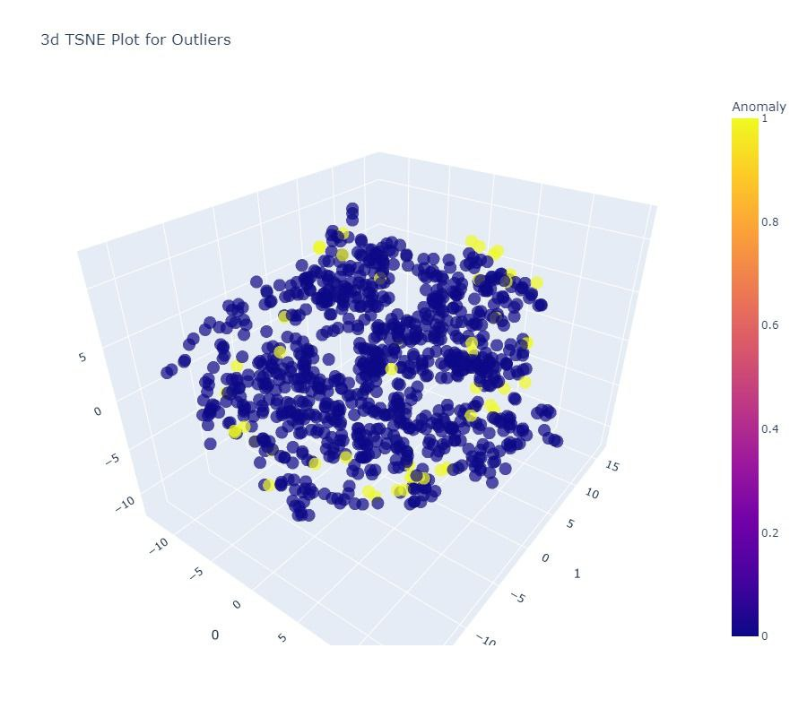
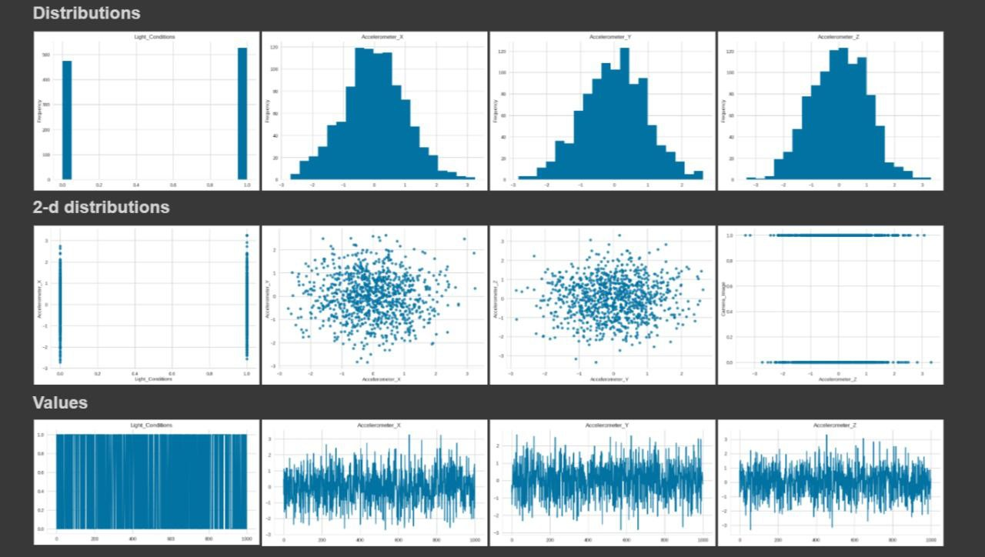
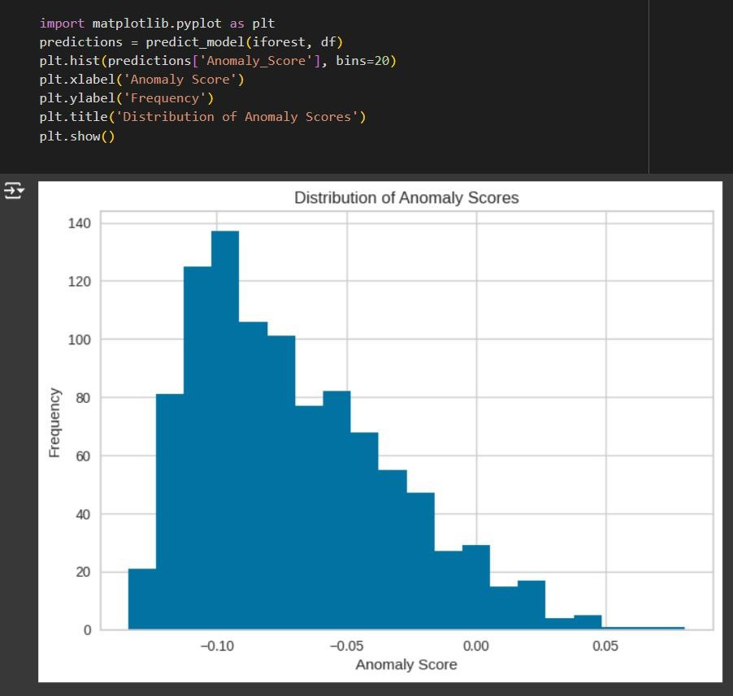
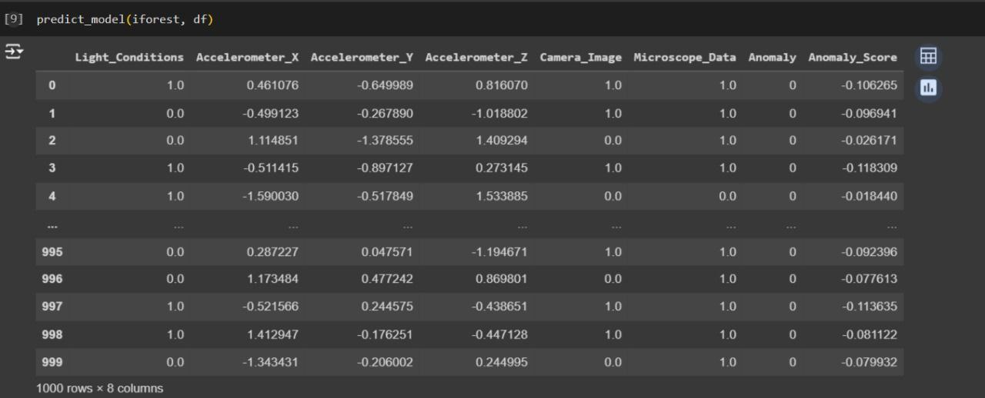
Results and Outputs

Slide 9
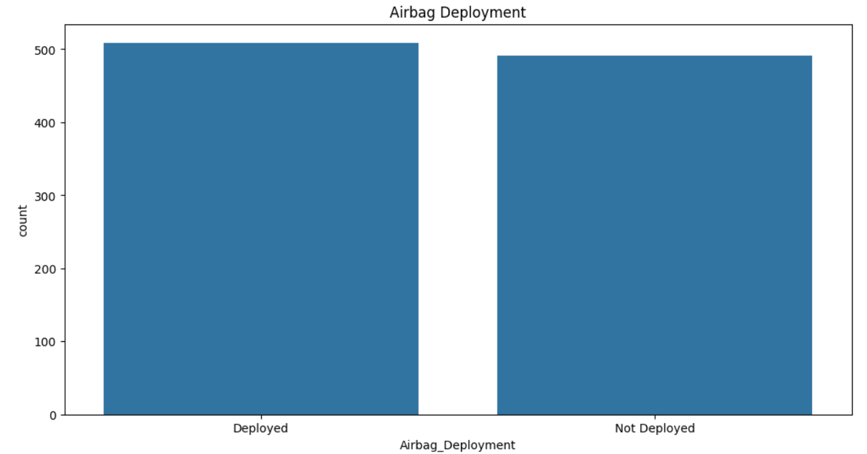
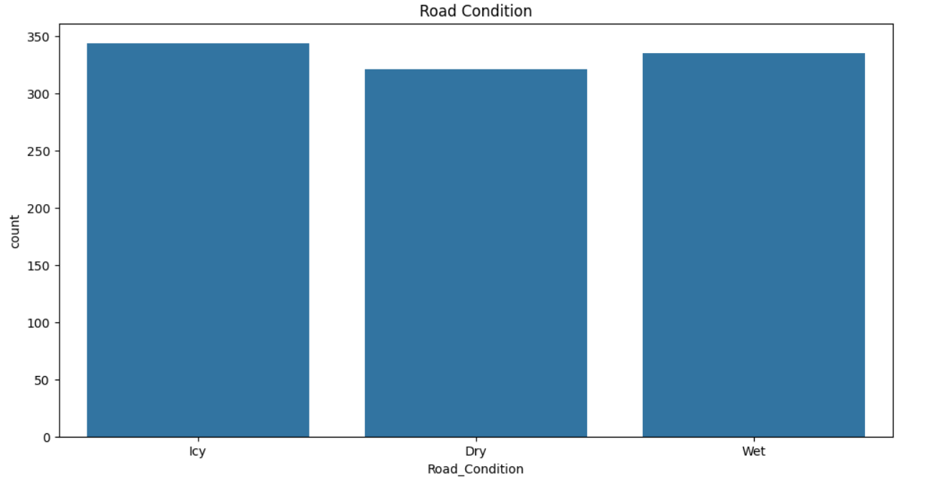
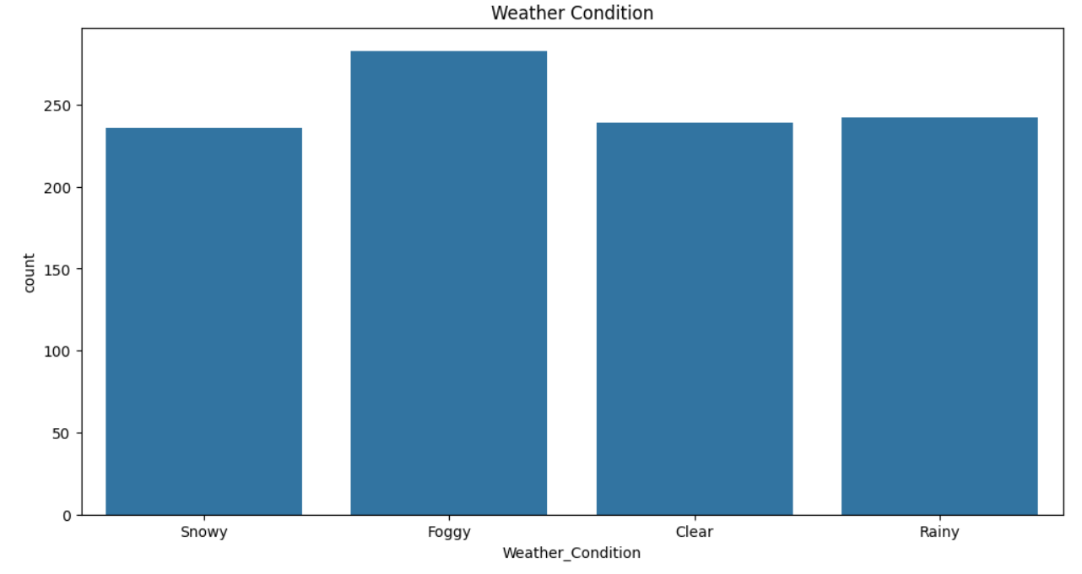
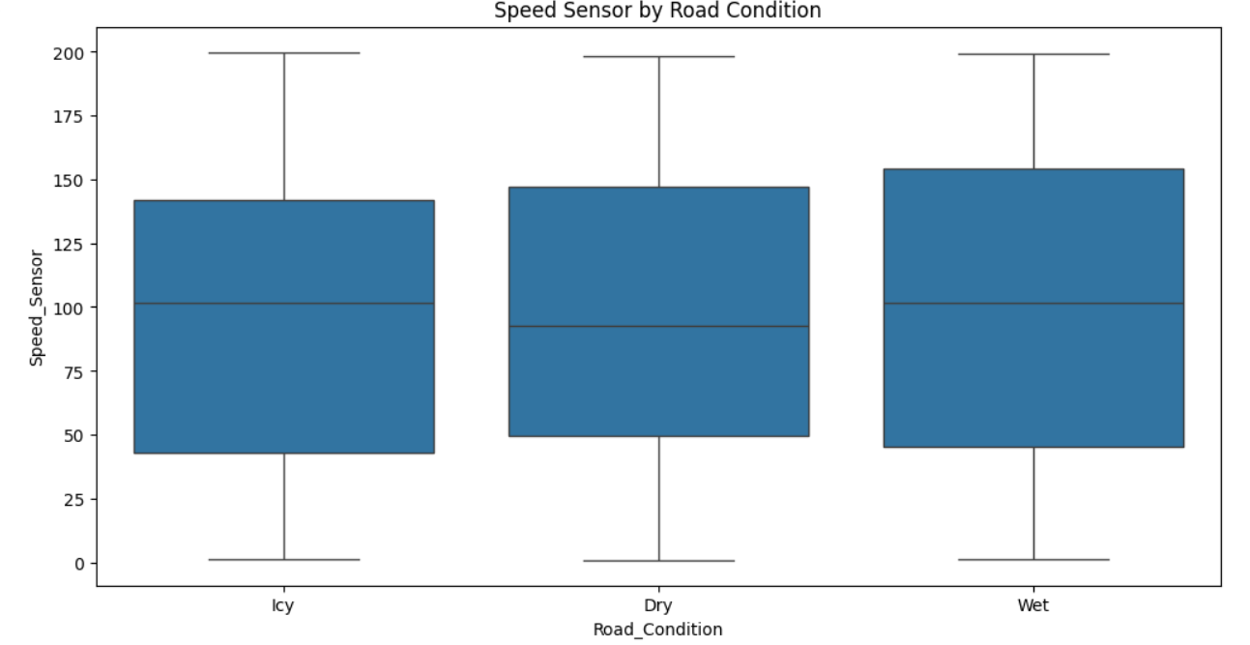
Results and Outputs

Slide 10
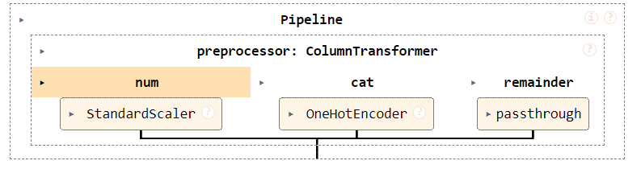
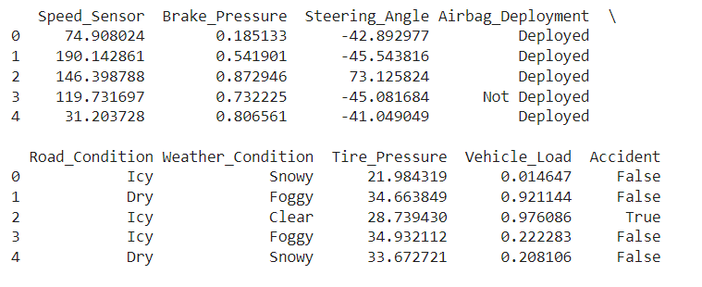
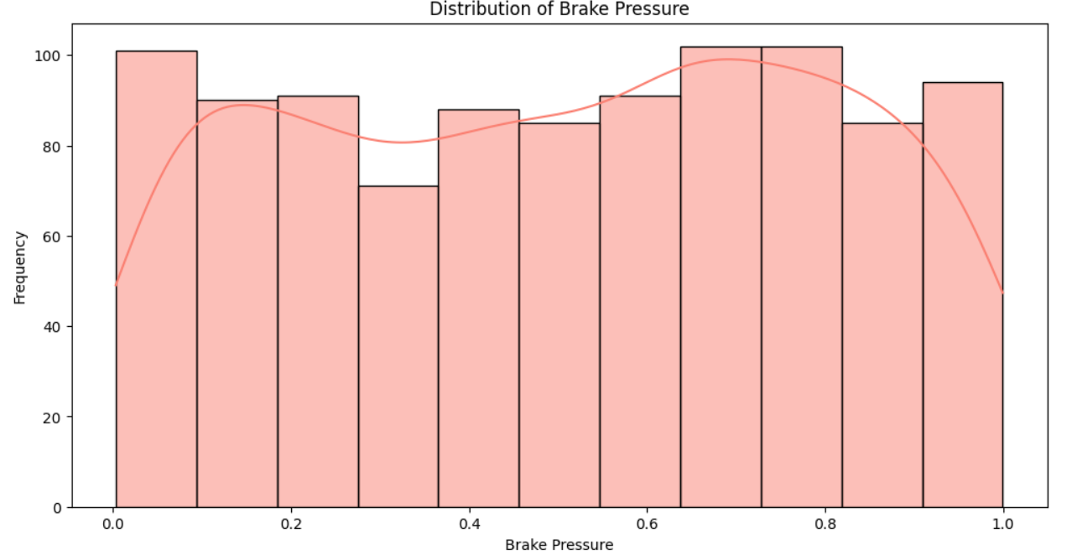
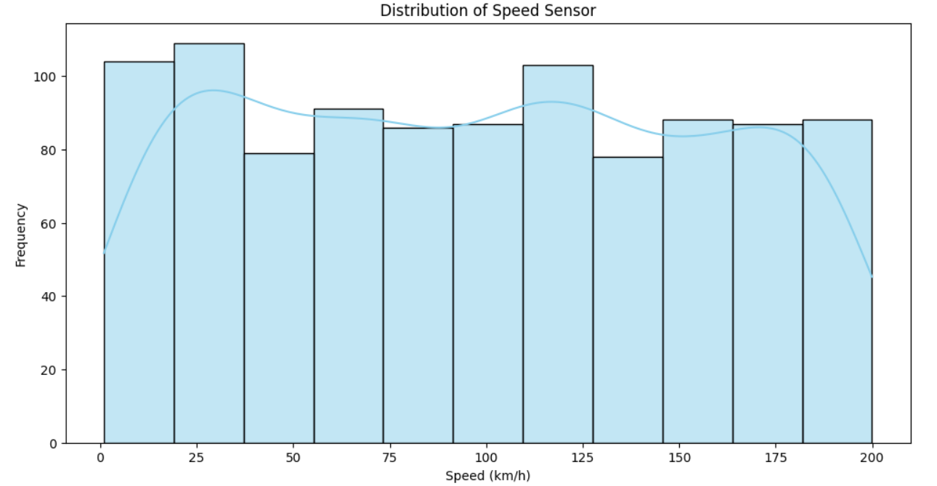
Results and Outputs

Slide 11
Conclusion
Blind Spot Detection with AI: Using AI to detect vehicles in blind spots can greatly enhance driver awareness and reduce accidents by making quick, reliable decisions.
Driver Behavior Analysis: Monitoring driver behavior to detect signs of drowsiness or distraction can help prevent accidents, ensuring safer roads.
Sensor Fusion for Data Accuracy: Combining data from multiple sensors improves the reliability and accuracy of information, leading to better-informed, real-time decisions for enhanced vehicle safety.

Slide 12
Analysis of the Features Used in the Project
Sensor Fusion
Improves accuracy and reliability of environmental perception by combining diverse data sources. Reduces false detections and enhances overall safety.
Blind Spot Detection
Real-time monitoring minimizes the risk of collisions during lane changes. AI decision-making ensures safer driving actions based on dynamic road conditions.
Driver Drowsiness Detection
Early detection of fatigue-related driving issues enables timely alerts, reducing the likelihood of accidents caused by drowsy driving.
IoT Communication
Ensures low-latency communication, enabling fast response to critical situations. Supports continuous monitoring and updates to the AI models.
6. Automated Safety Responses
Provides immediate intervention in high-risk scenarios, significantly reducing the chances of accidents. The system acts as an additional layer of protection beyond driver control.

Slide 13
References
[1] S. S. Rao et al., "Sensor and Sensor Fusion Technology in Autonomous Vehicles," IEEE Transactions on Intelligent Transportation Systems, vol. 22, no. 4, pp. 1011-1022, 2021.
[2] J. Liu et al., "Sensor Fusion for Autonomous Vehicles: A Review," IEEE Sensors Journal, vol. 21, no. 10, pp. 2531-2544, 2021.
[3] Y. Zhang et al., "Blind Spot Detection for Autonomous Vehicles Using Computer Vision," IEEE Transactions on Intelligent Transportation Systems, vol. 21, no. 5, pp. 1231-1242, 2020.
[4] H. Lee et al., "Sensor Fusion-Based Blind Spot Detection for Autonomous Vehicles," IEEE Sensors Journal, vol. 20, no. 12, pp. 3121-3132, 2020.
[5] S. K. Goyal et al., "Driver Drowsiness Detection Using Artificial Intelligence and IoT," IEEE Transactions on Intelligent Transportation Systems, vol. 21, no. 1, pp. 201-212, 2020.

Slide 14
Thank you

